Slide 1
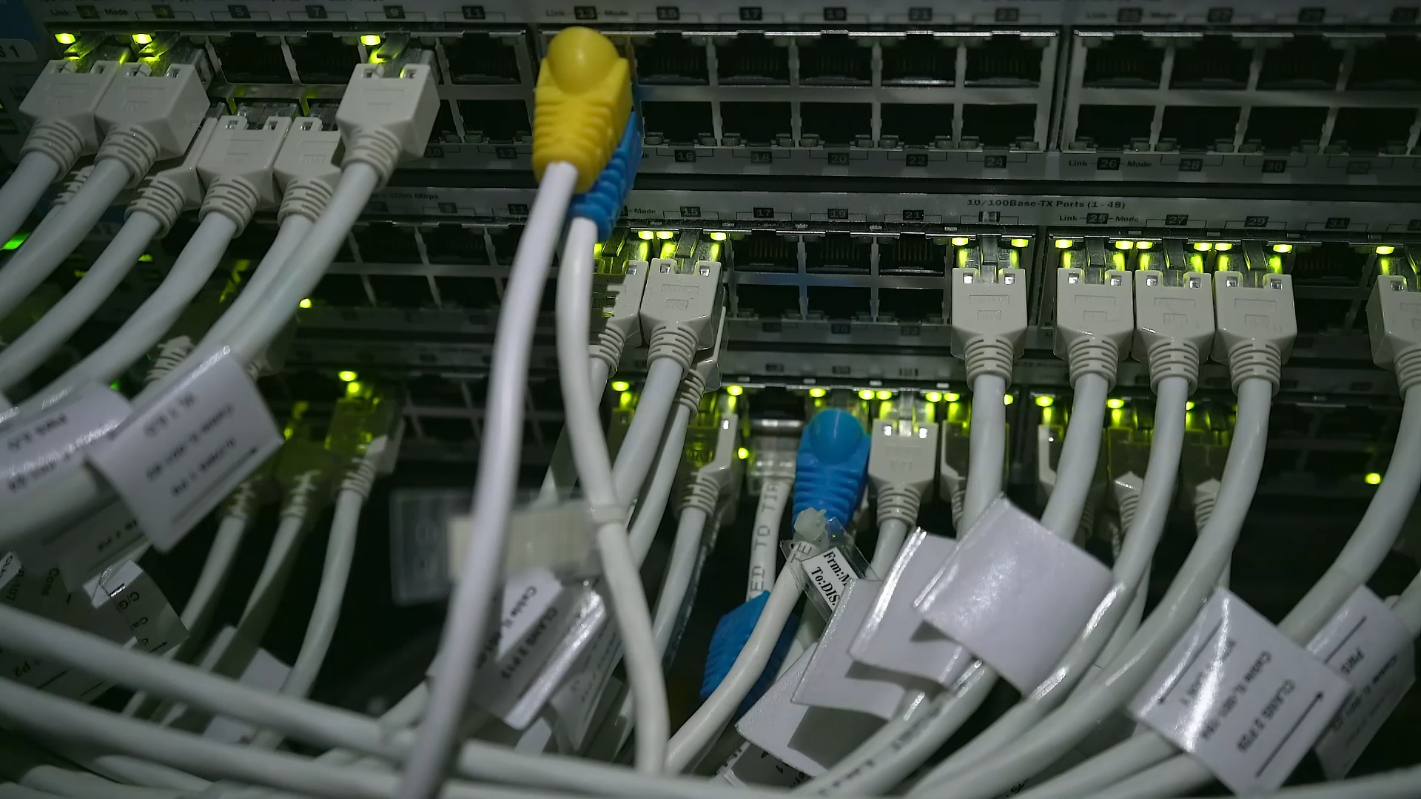
How does the internet work?
Please sit at a number

Slide 2
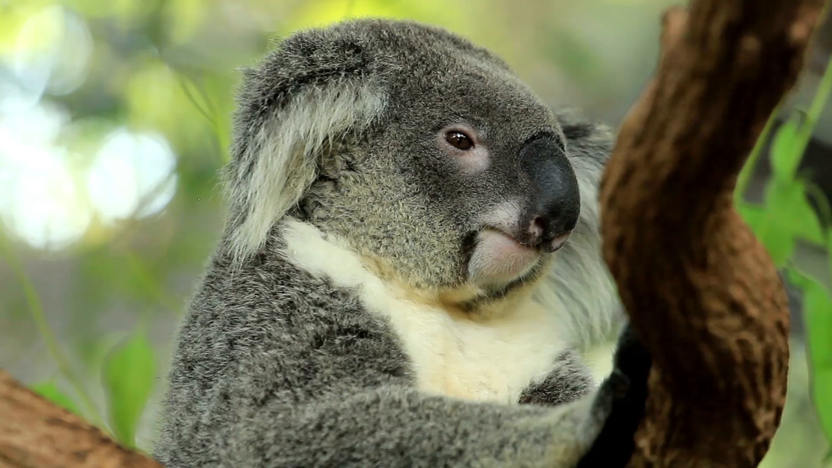
My name is Kyle

Slide 3


Slide 4


Slide 5
GenCyber Networking!
How The Internet Works

Slide 6
Today’s Goodies
With a bit of string,
and various accessories…
Explain how the structure of the internet works
Demonstrate security issues that exist within the internet
…all without a computer

Slide 7
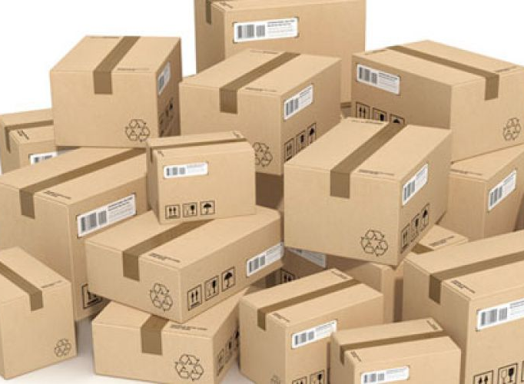
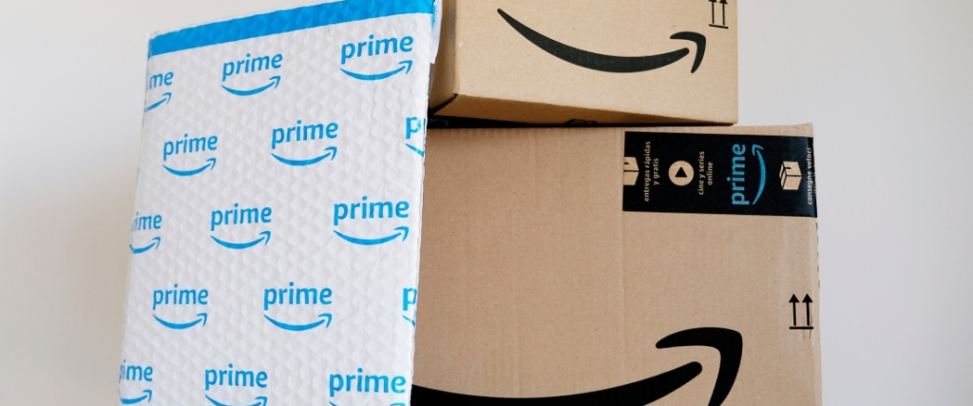
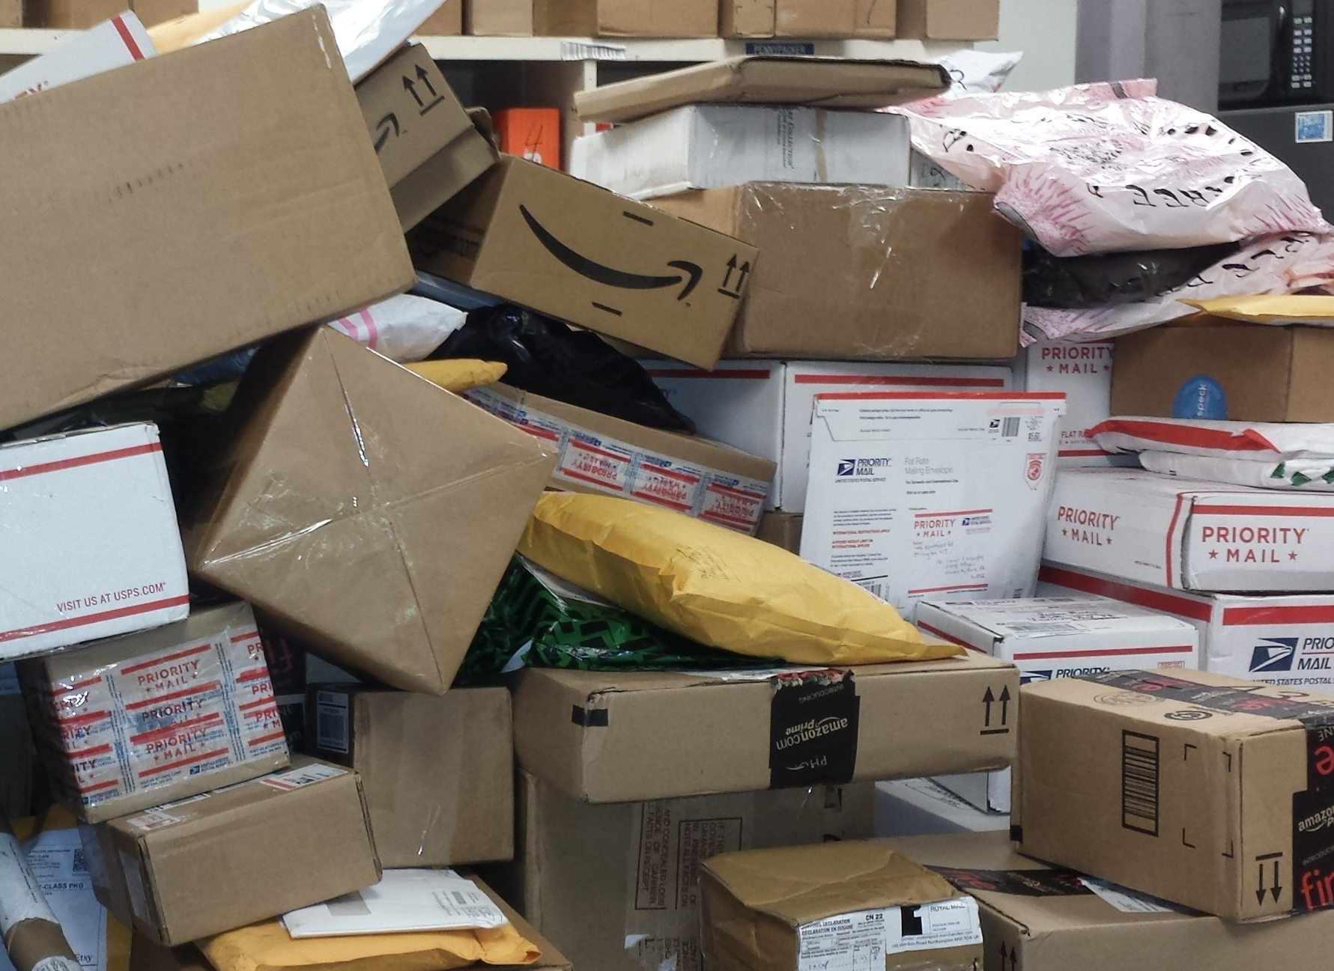
What’s this?

Slide 8
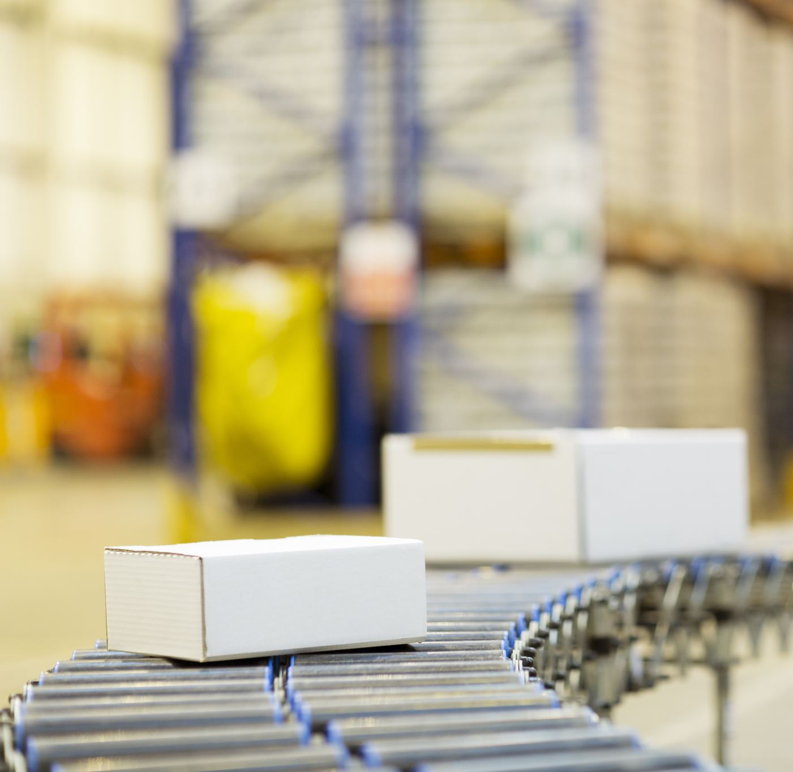
Packages!
Each package has something inside of it

Slide 9

package = packet
On the internet

Slide 10
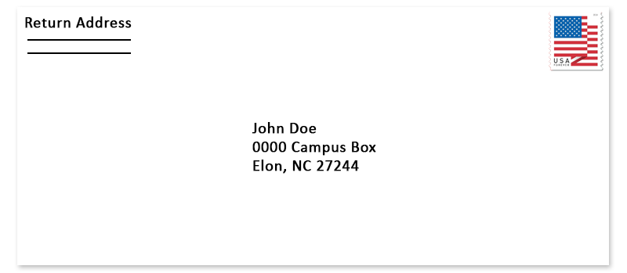
There’s an important number on there…
What is it?

Slide 11
IP has a problem…
Each “octet” can only go up to 255…
Smallest to largest IP: 0.0.0.0 through 255.255.255.255
255 * 255 * 255 * 255 = 4,228,250,625 IPs
Will we run out?

Slide 12
What do we use a zip code for?

Slide 13
Zip Codes = IP Addresses
IP Address: Internet Protocol Address

Slide 14
IP’s are Important!
Without them, the internet won’t work!
Without zip codes, your mail won’t get delivered!
They look like this:
138.247.240.84

Slide 15
IPv6
The old IP system -> ran out already… ☹
New system! Uses hex!
Look like:
3.4 x 10³⁸ total addresses
  ^{That’s a lot}
2001:0db8:0000:0042:0000:8a2e:0370:7334

Slide 16
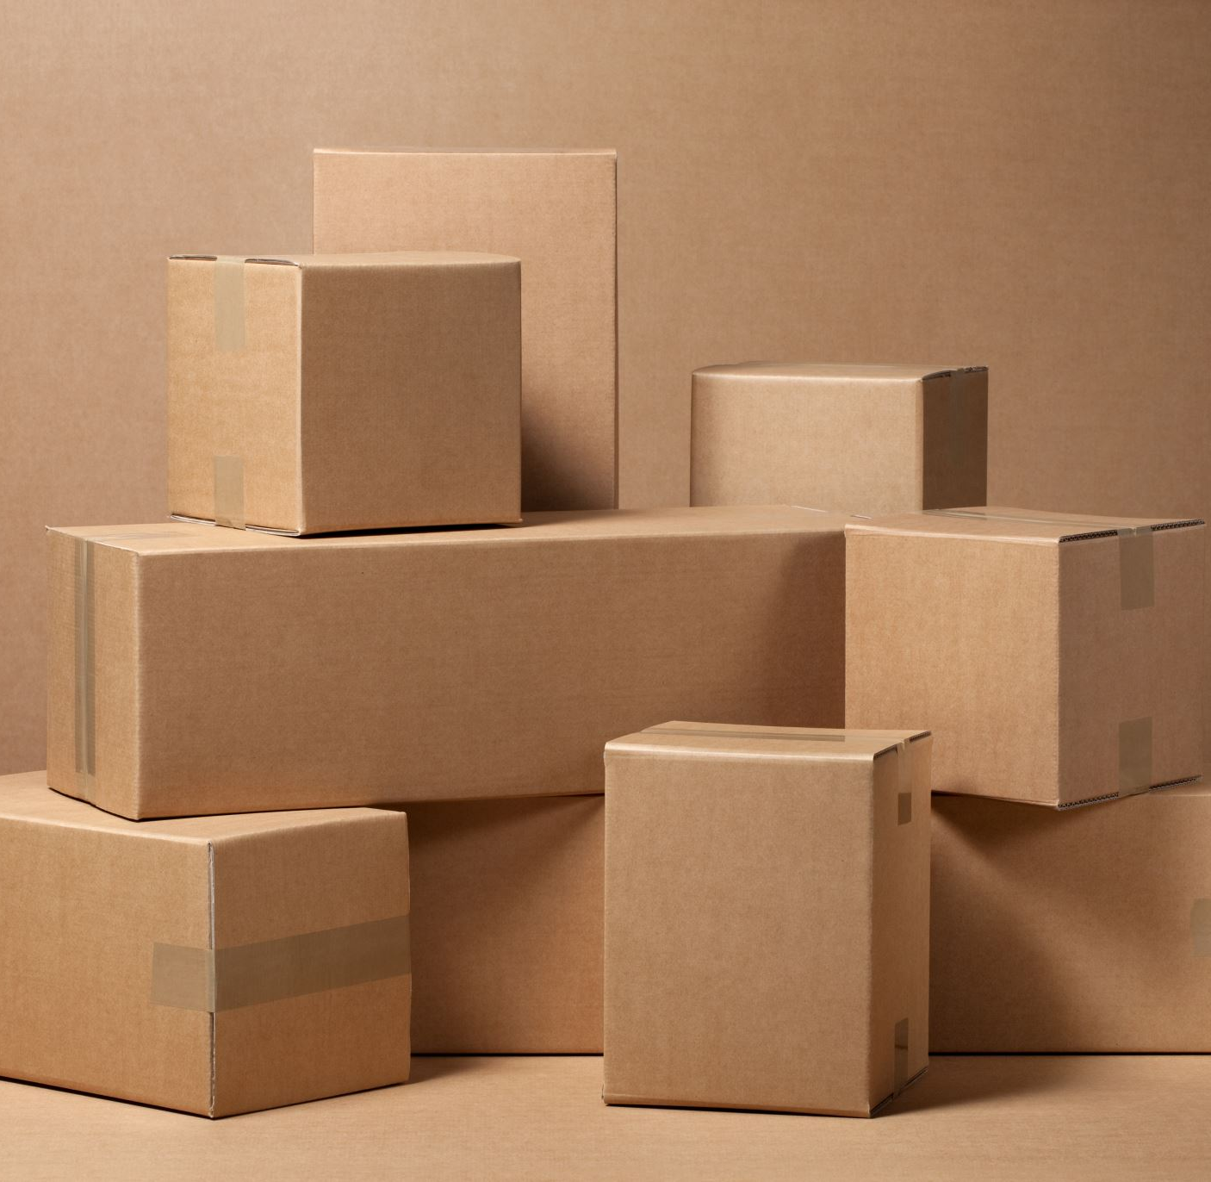
Who delivers your mail?

Slide 17
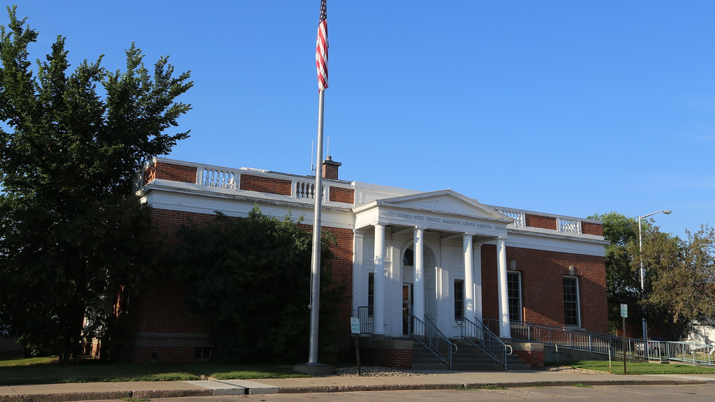
The Post Office

Slide 18
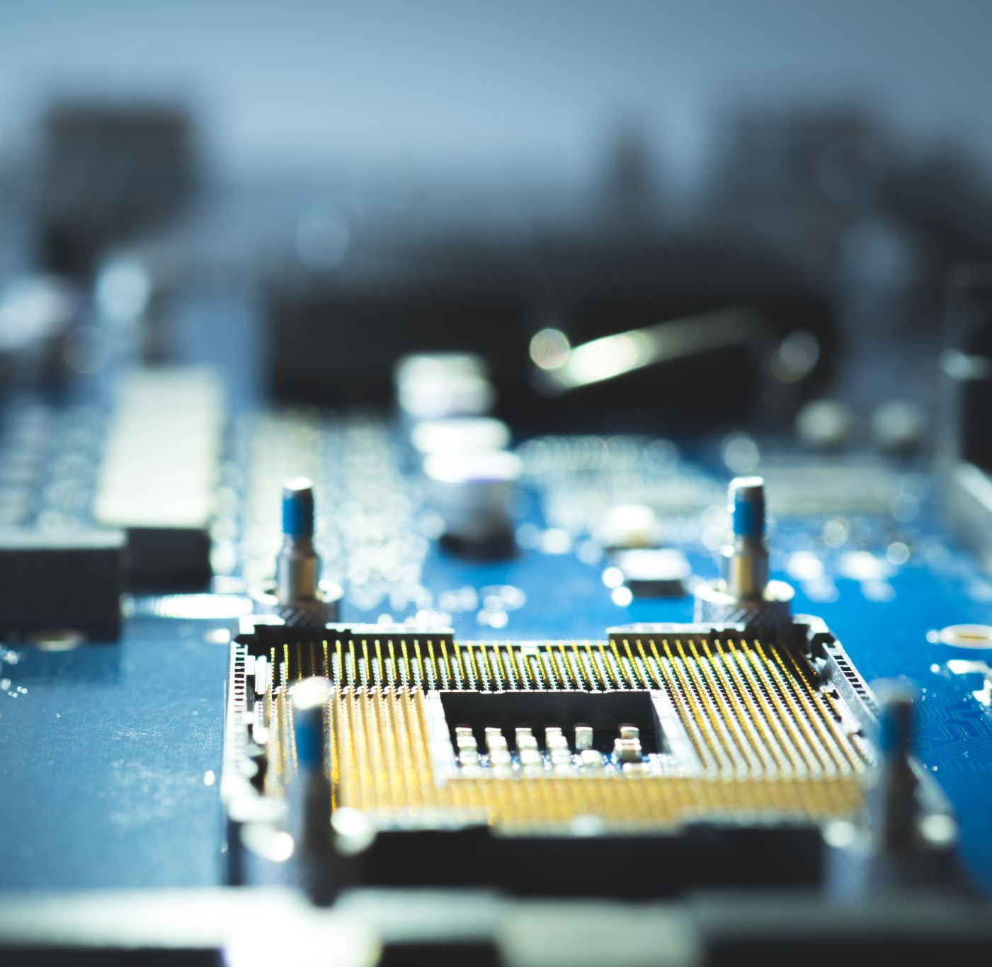
What delivers packets?

Slide 19
Routers!

Slide 20
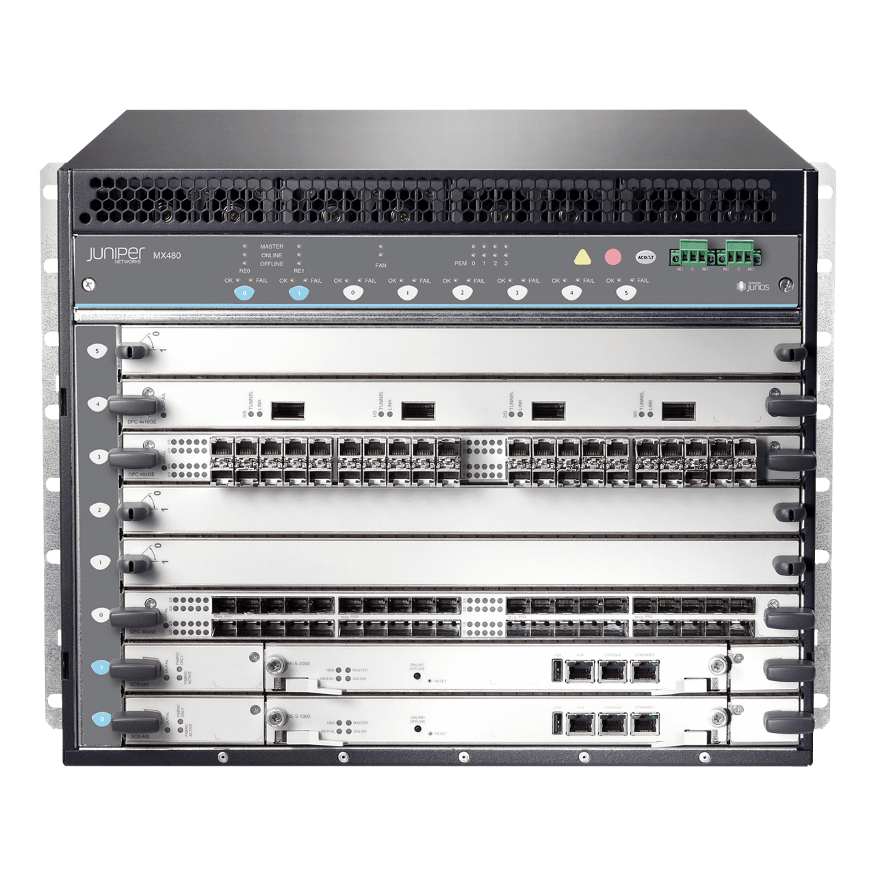
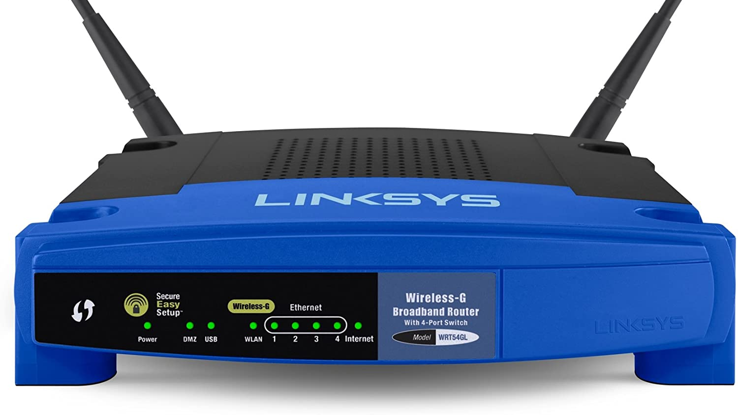
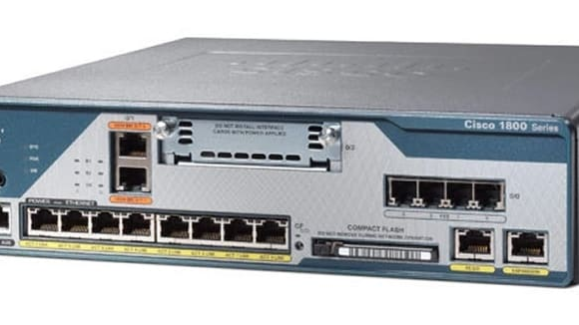
All shapes & sizes

Slide 21
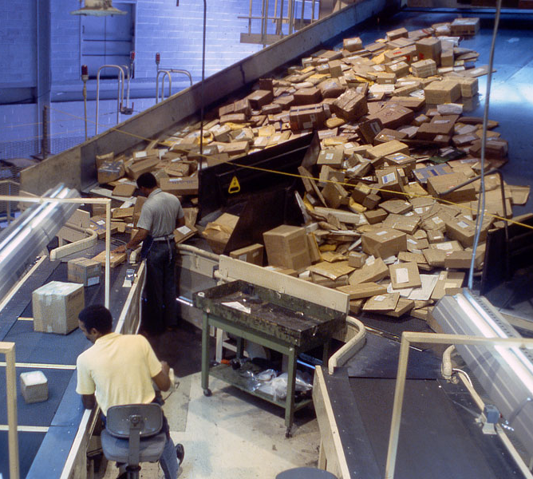
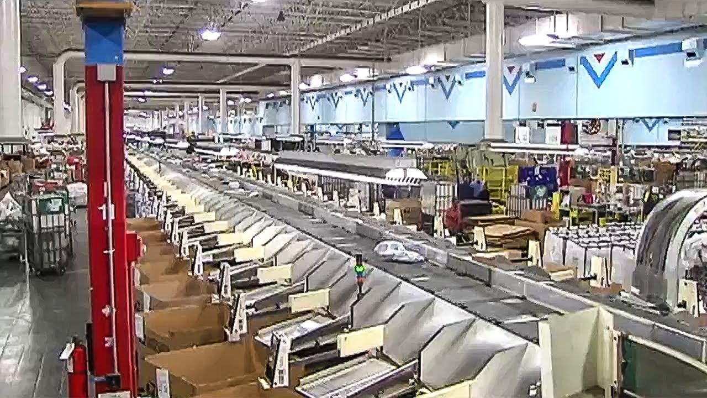
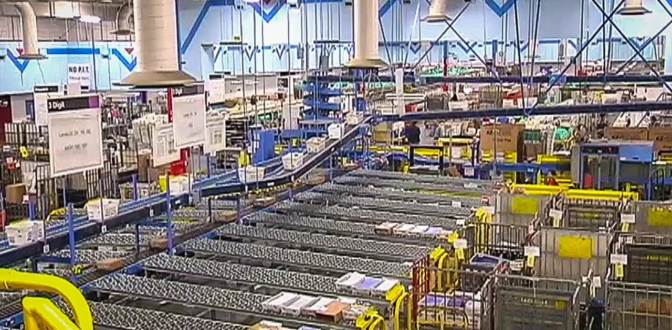
This is a big post office

Slide 22
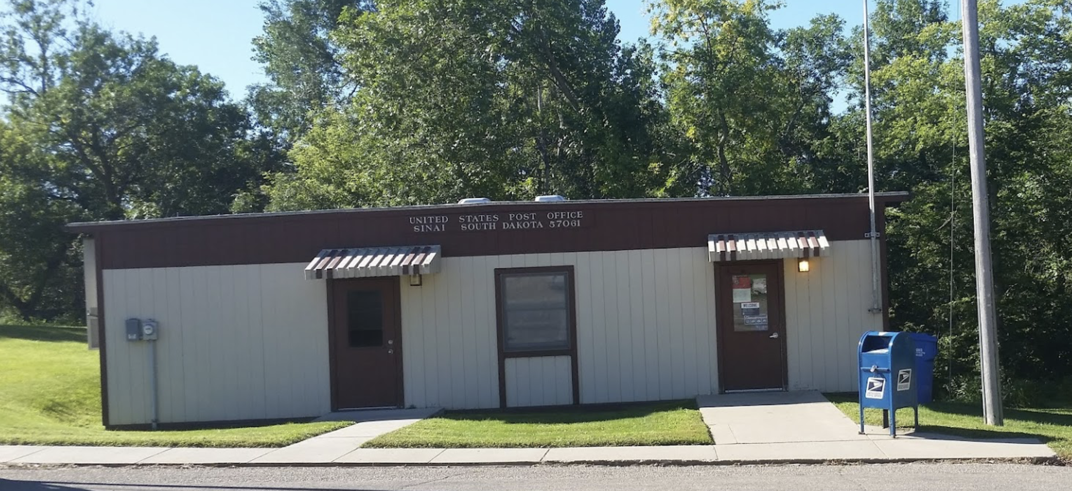
This one is little

Slide 23
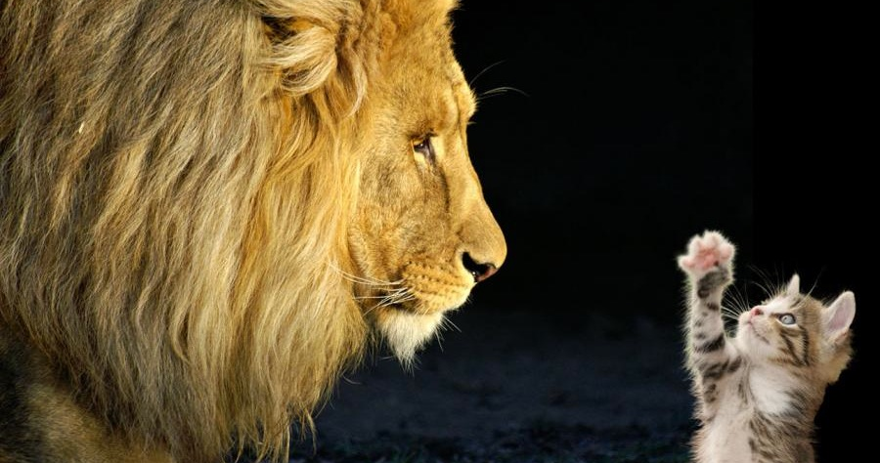
Notes:
How does mail sorting/delivery really work then? Big vs small? Just like routers

Slide 24

What does your router look like?

Slide 25
DSU’s router is big
Connects across the state
  Main link: 100gb/s
  Secondary links: 10gb/s
  Tertiary links: 1gb/s

Slide 26
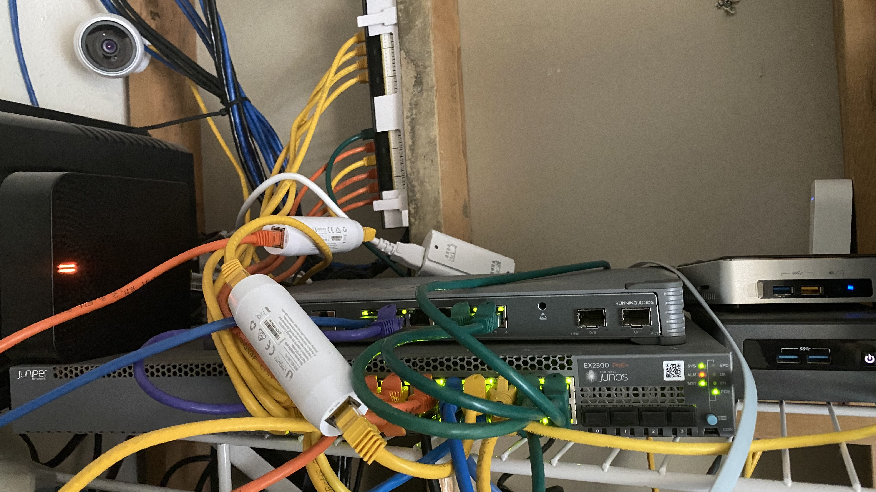
This is my router

Slide 27

How do we communicate around the world?
Notes:
We know the post office has their mail mobile, planes, people walking around an sorting stuff, big trucks, etc

Slide 28
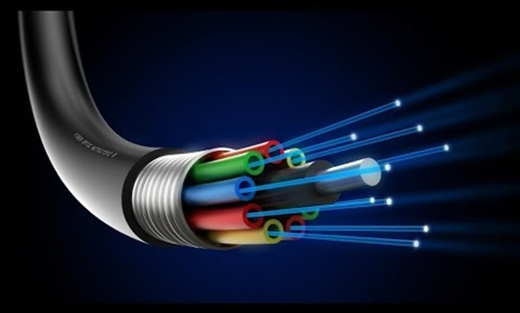

Slide 29

Across oceans?

Slide 30
https://www.SubMarineCableMap.com

Slide 31

What route do your packets take?
Notes:
https://stefansundin.github.io/traceroute-mapper/

Slide 32
How do routers work?
Just like the post office!
They look at the IP address
If they know where it belongs, they send it there
If they don’t know, they send it somewhere else

Slide 33
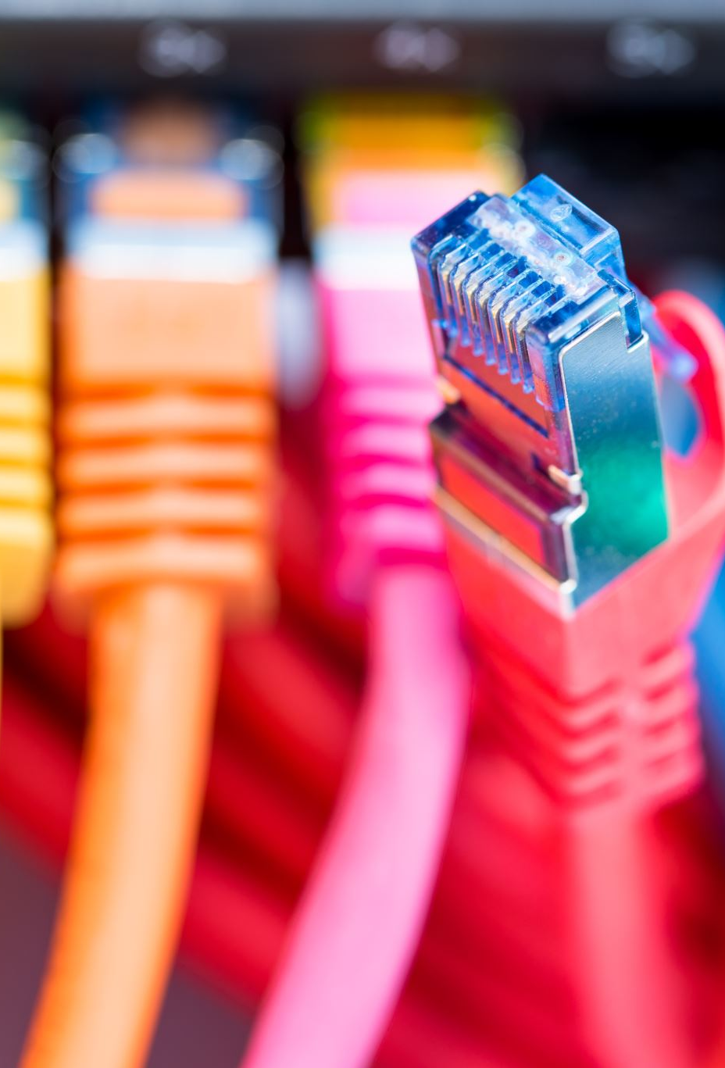
Let’s build the internet!
Everyone already has an “address”
The string will be our cable
You will be a router!
Your job: Route your packets!

Slide 34
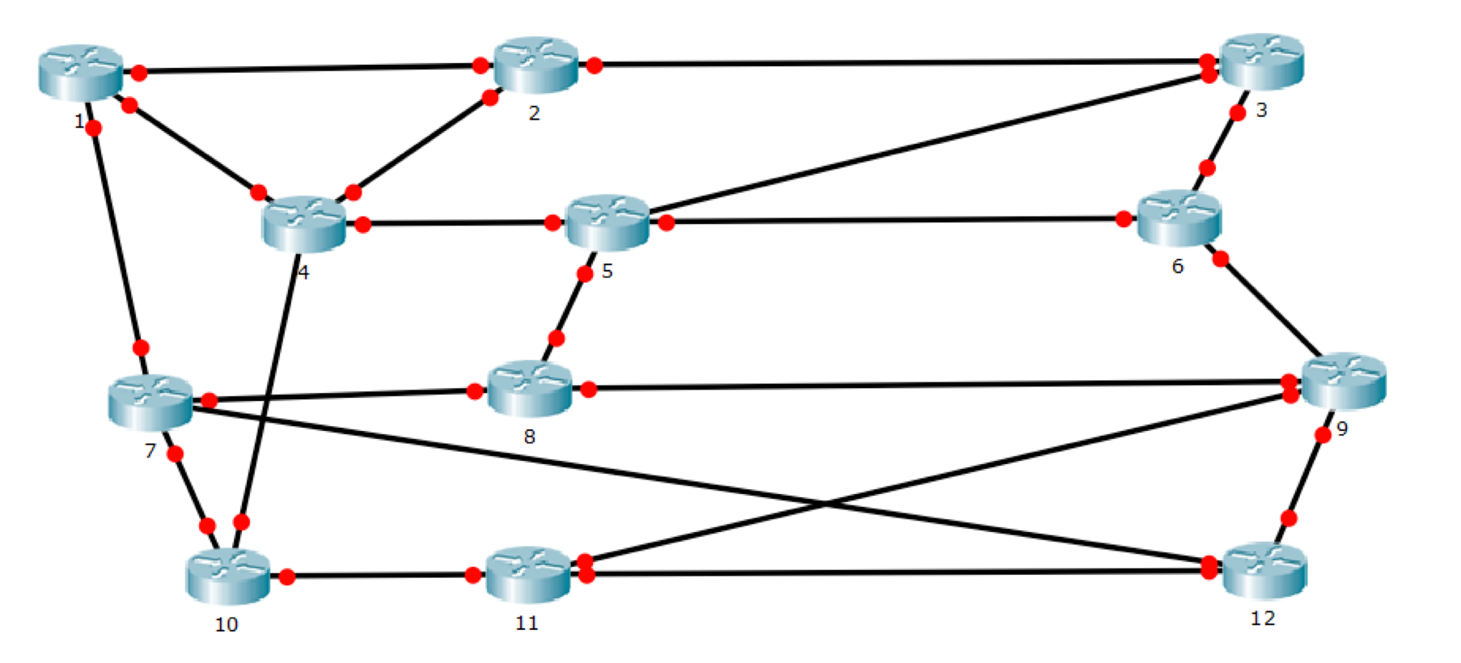


Slide 35
What can go wrong?
Someone tampers?
String breaks?
Overwhelmed?
Collisions?

Slide 36

Security Concepts
We’re pretty ok at:
Availability
Defense In Depth
Needs work:
Integrity

