Slide 1
Internet of Strings
InternetOfStrings.xyz

Slide 2
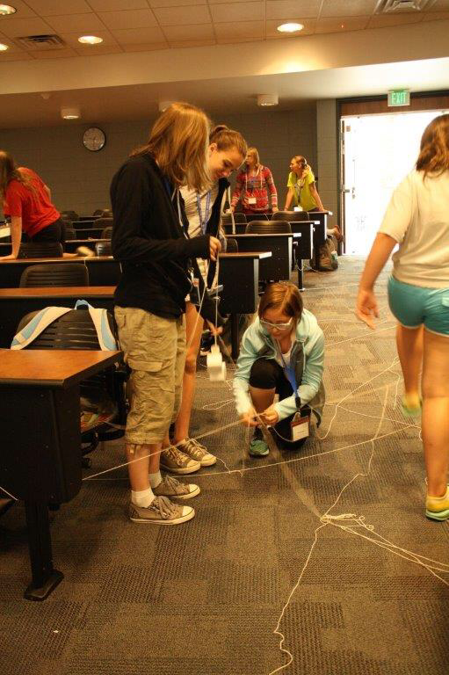
Objective
Simulate how networks/routers work
What security problems can exist?
Toss in some security principles
Add a little chaos to life

Slide 3
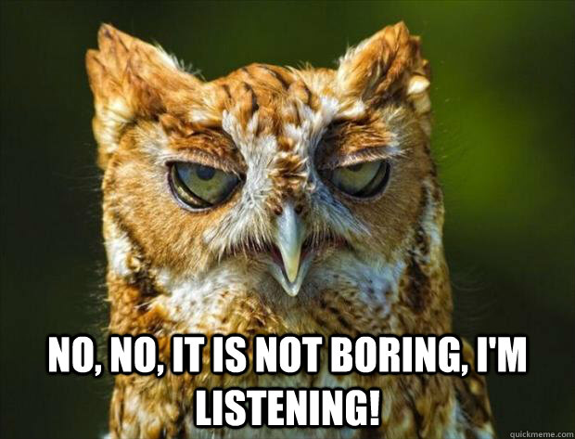
The Problem: Networking

Slide 4
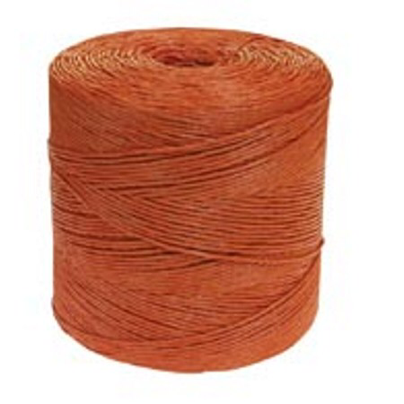
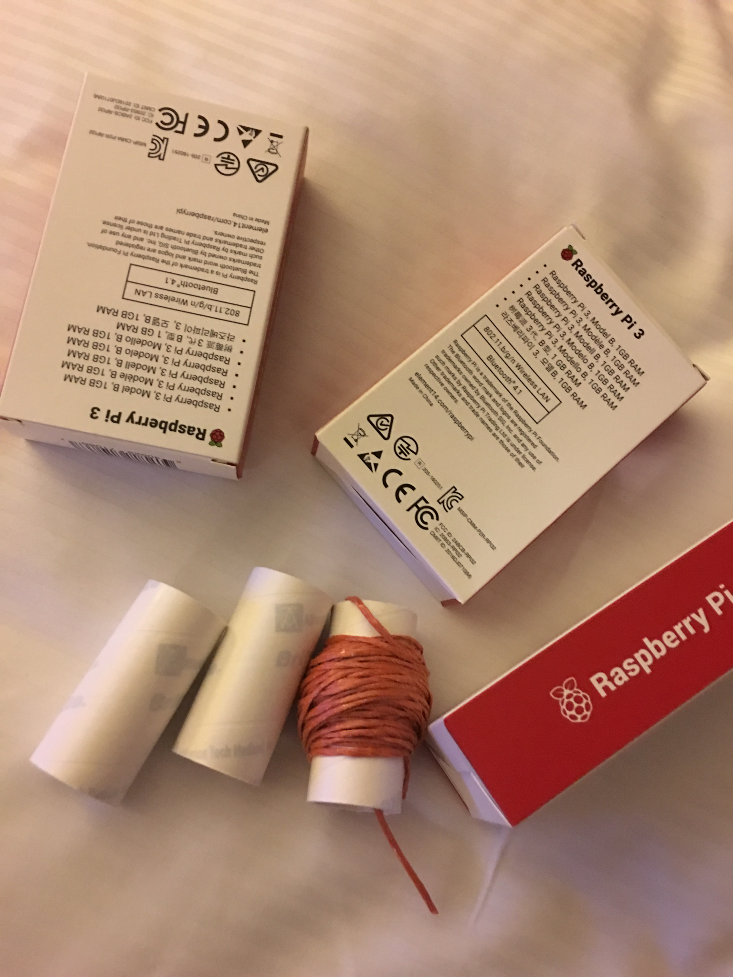
Required Equipment
Tube
Box
String
Candy?

Slide 5
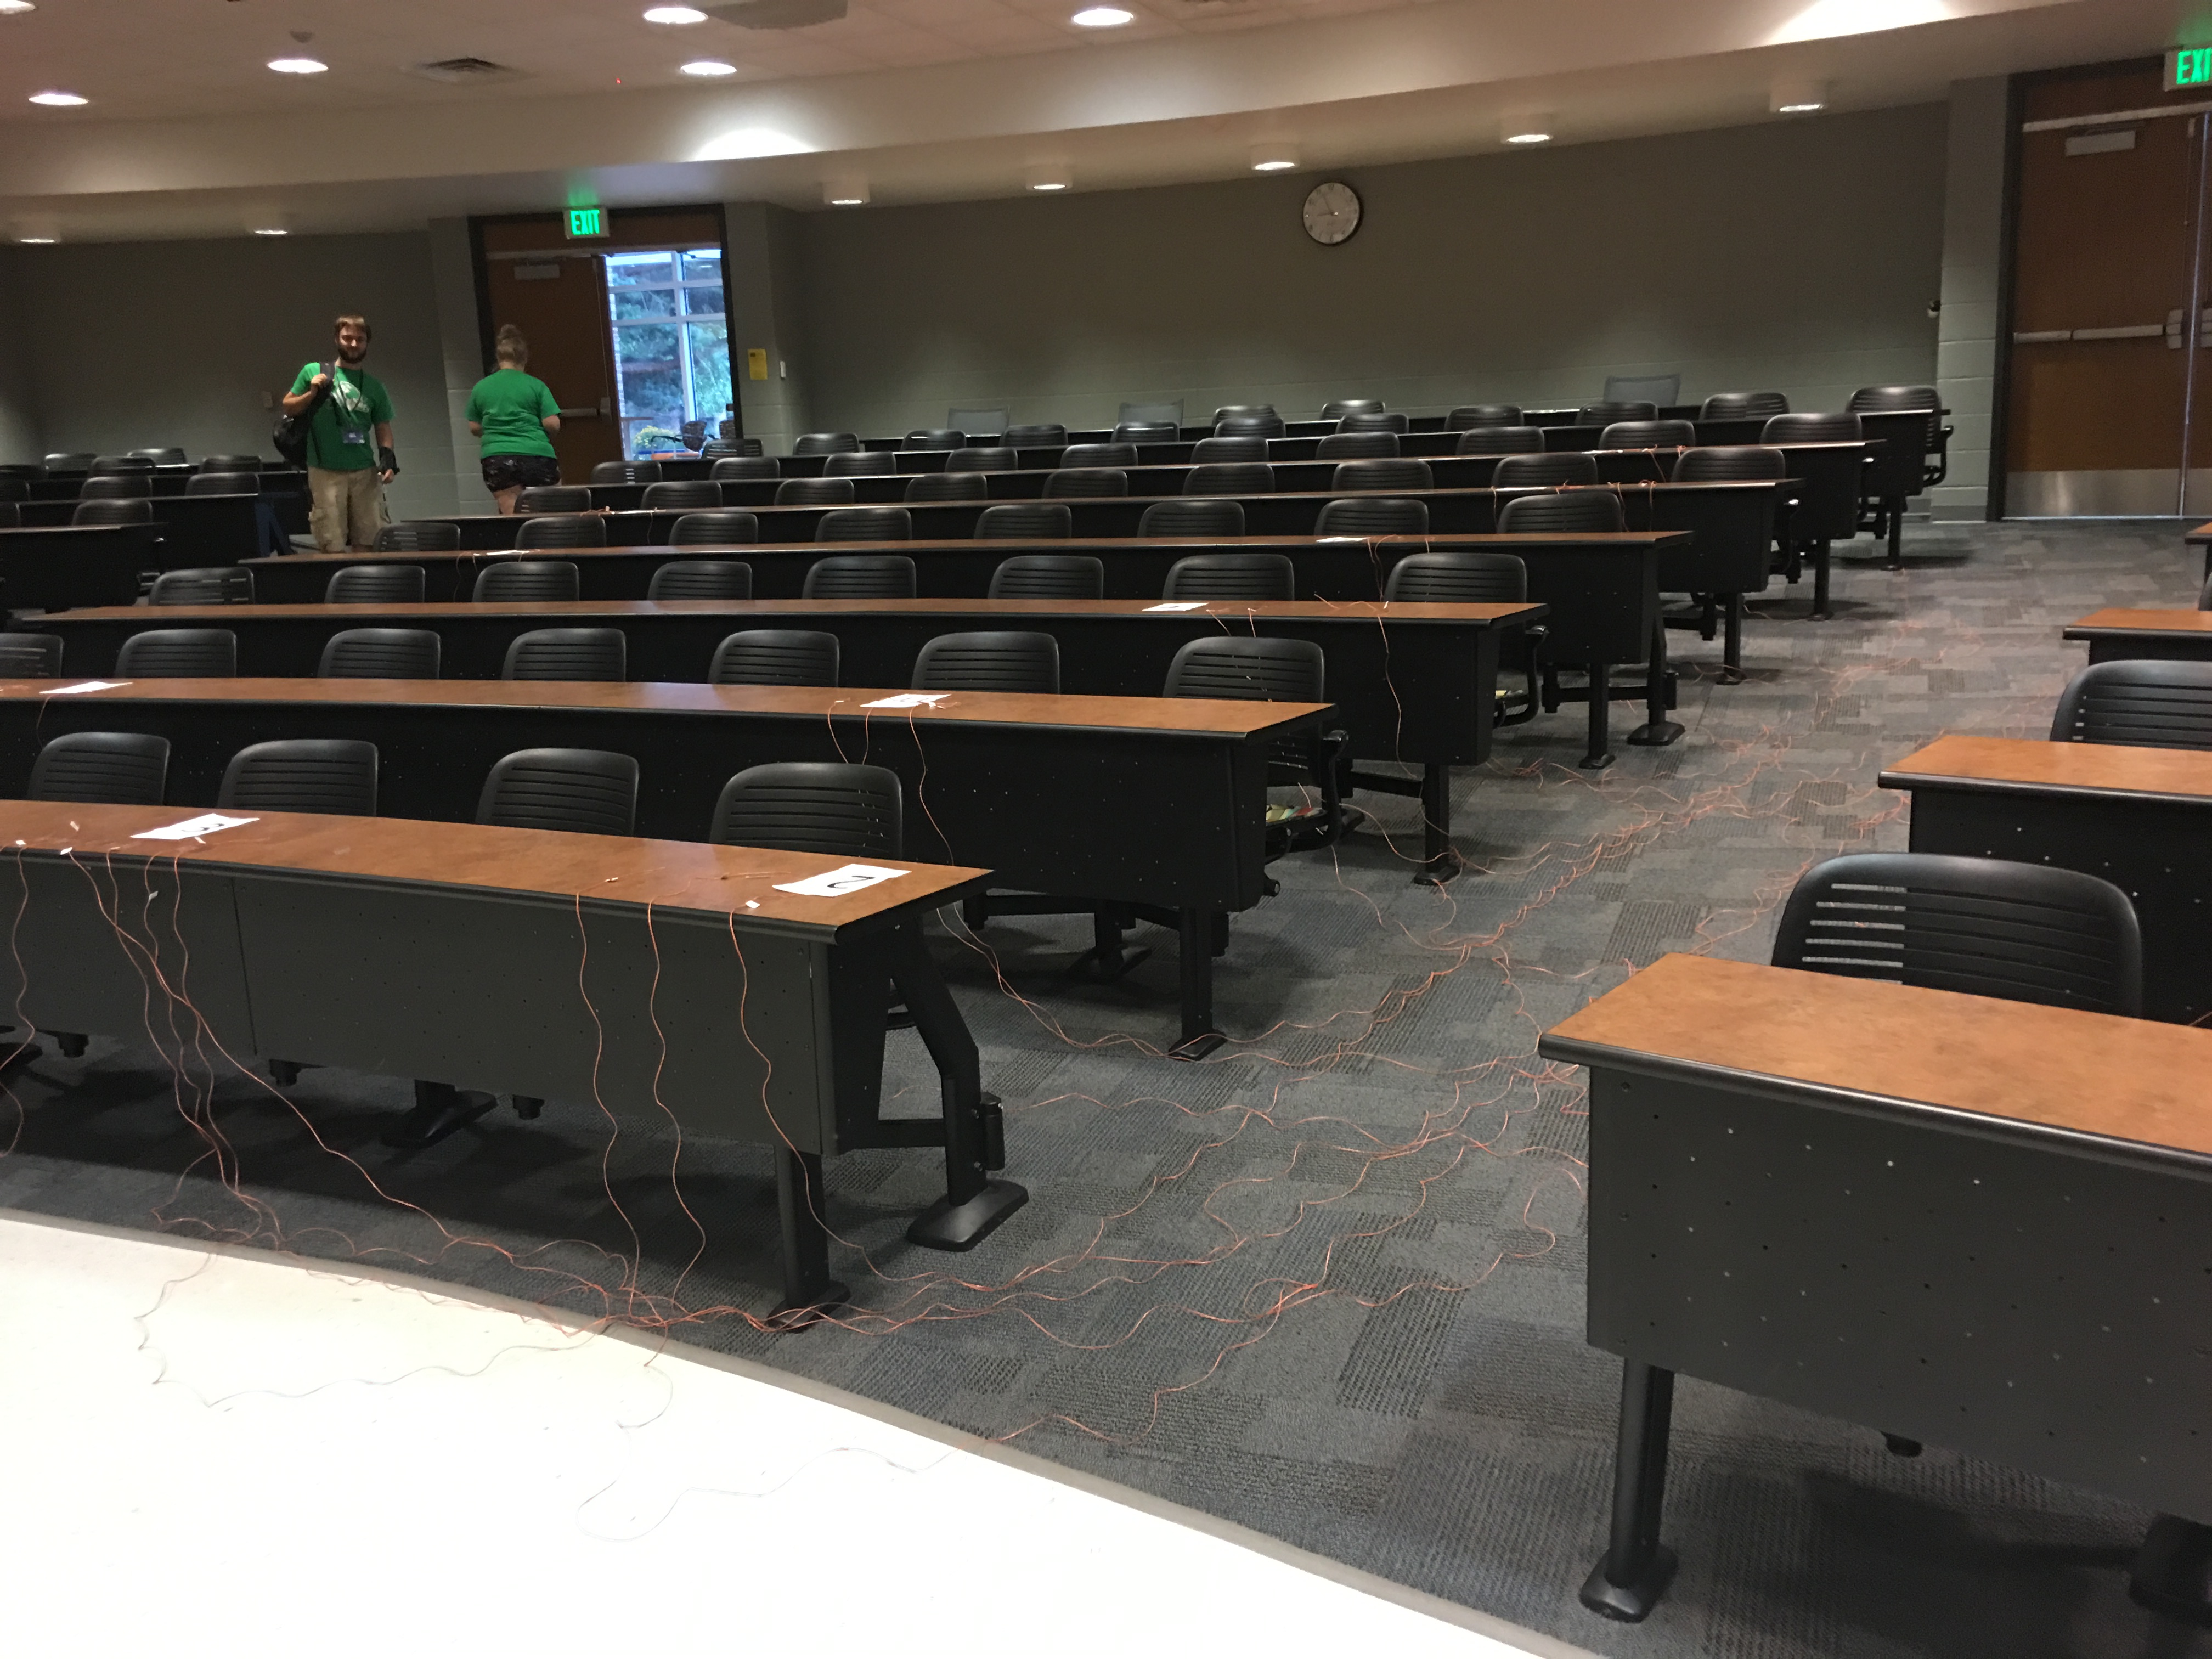

Slide 6
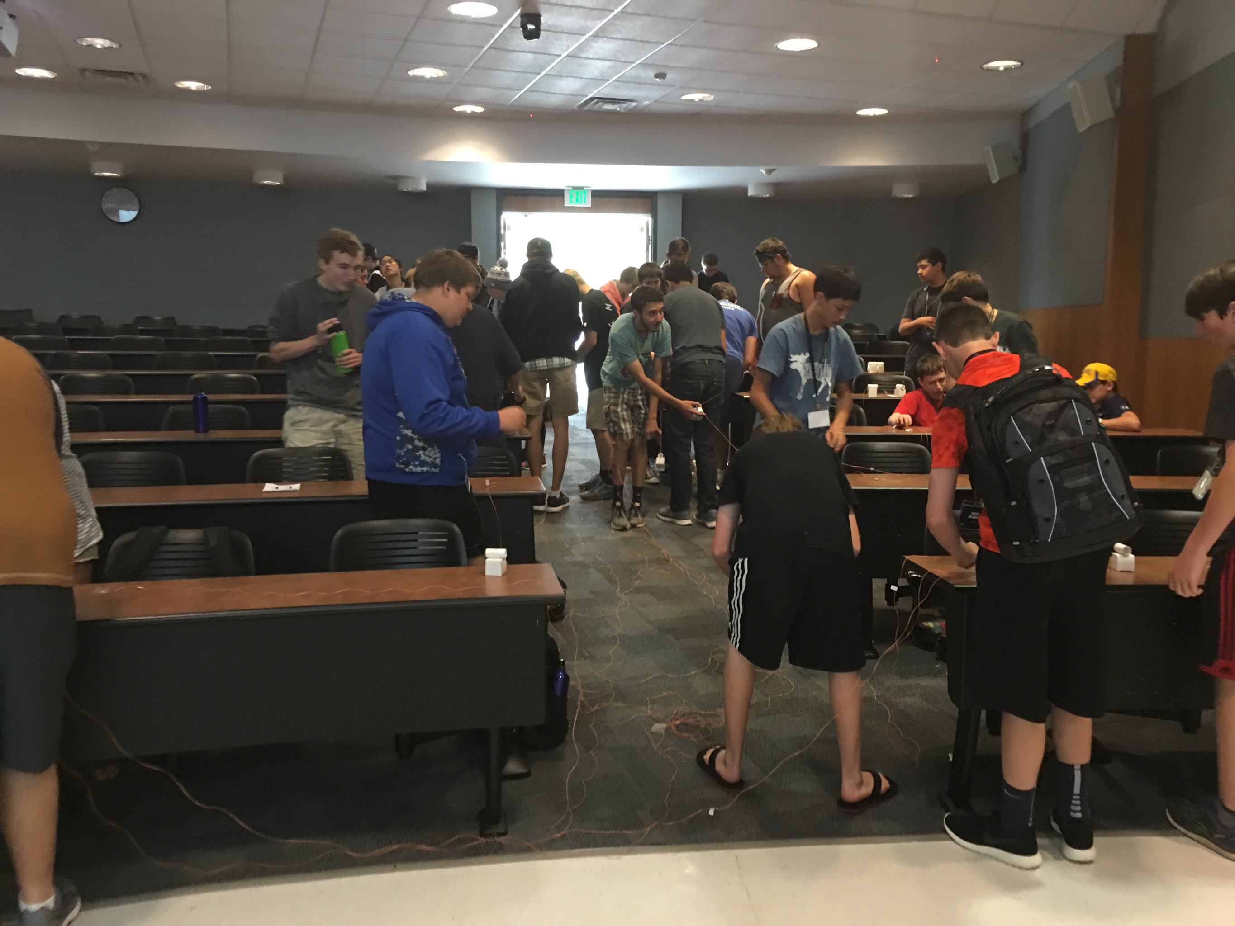
The Activity
Route a packet!

Slide 7
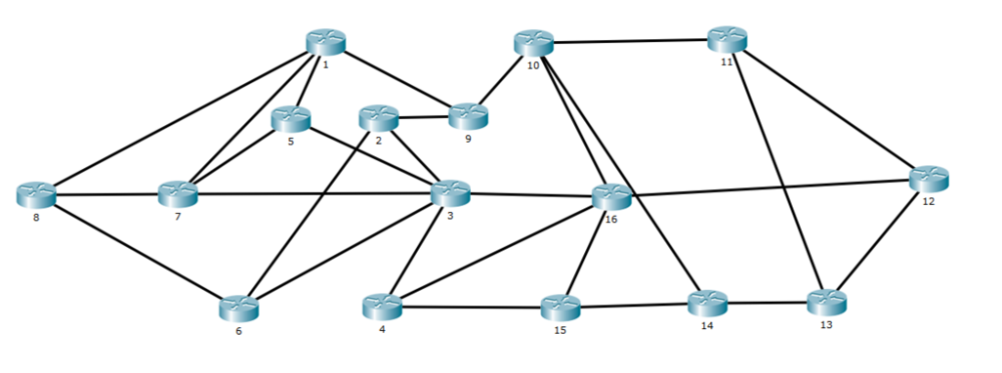

Slide 8
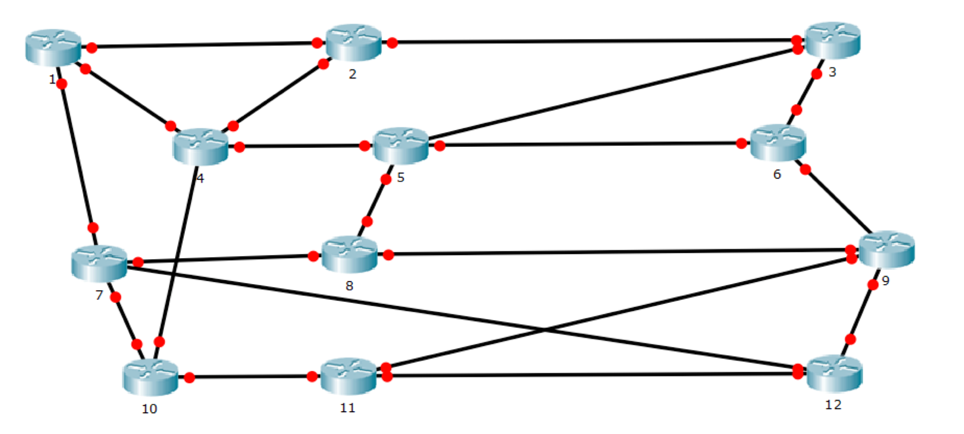

Slide 9
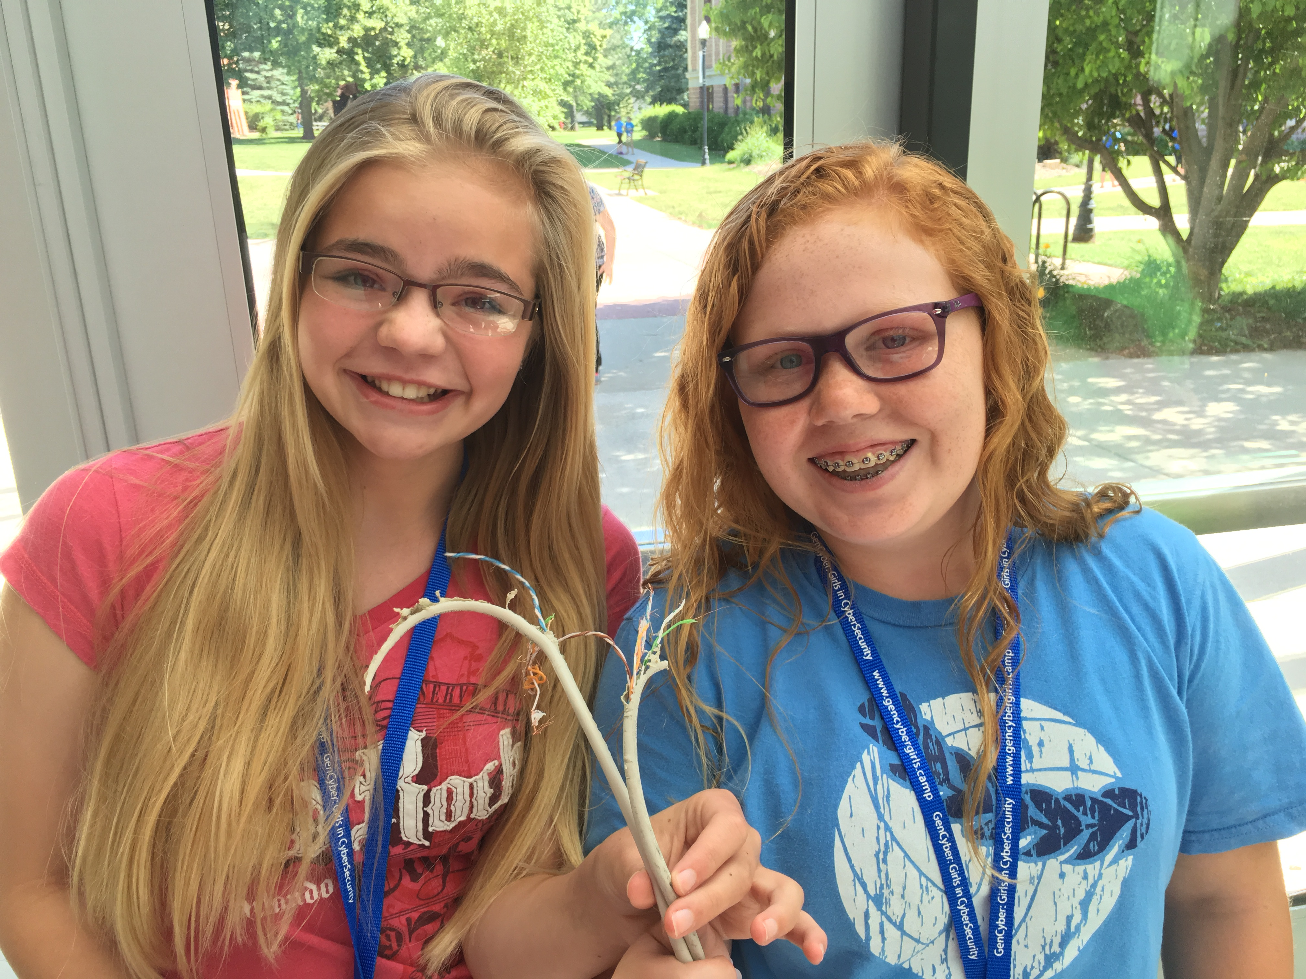
What Goes Wrong
Links "go offline"
An overwhelmed router?
Tampering
Collisions

Slide 10
Security Principles
Encapsulation (candy contained in the packet)
Modularity (add, remove, re-converge routers on internet)
Abstraction (simulating how the internet works, offline)
Layering (decisions made at different levels)

